Slide 1
Database design
CSE3207 Project #1
Assignment Date : March 21th, 2018
Due Date : April 27th, 2019
Notes:
The first project of this course is implementing the disk….
Today we’ll briefly introduce about project.

Slide 2
Table of contents
Project description
Environment setting
Notes:
As you already know, B+tree is the most Widely Used Index structure.
B+tree represents sorted data in a way that allows for efficient insertion, retrieval and removal of records, each of which is identified by a key.
In a B+ tree, all records are stored at the leaf level of the tree; only keys are stored in interior nodes.
It is a dynamic, multilevel index, with maximum and minimum bounds on the number of keys in each index segment (usually called "node").
In our disk based structure, A B+Tree stored in a single data file. A node is corresponding to a page.
Pages are stored in data file. If you need a certain page in the data file, you have to find the page and load to memory.
PID(Page ID) stores a page index in the B+Tree data file.
Using this page ID, we can seek the position of necessary node in the file.

Slide 3
Project Description
You need to design database for Movie
You need to design 13 Table in DB
director (directorID, directorName, dateOfBirth, dateOfDeath)
actor (actorID, actorName, dateOfBirth, dateOfDeath, gender)
movie (movieID, movieName, releaseYear, releaseMonth, releaseDate, publisherName, avgRate)
award (awardID, awardName)
genre (genreName)
movieGenre (movieID, genreName)
movieObtain (movieID, awardID, year)
actorObtain (actorID, awardID, year)
directorObtain (directorID, awardID, year)
cast (movieID, actorID, role)
make (movieID, directorID)
customerRate (customerID, movieID, rate)
customer (customerID, customerName, dateOfBirth, gender)
Notes:
As you already know, B+tree is the most Widely Used Index structure.
B+tree represents sorted data in a way that allows for efficient insertion, retrieval and removal of records, each of which is identified by a key.
In a B+ tree, all records are stored at the leaf level of the tree; only keys are stored in interior nodes.
It is a dynamic, multilevel index, with maximum and minimum bounds on the number of keys in each index segment (usually called "node").
In our disk based structure, A B+Tree stored in a single data file. A node is corresponding to a page.
Pages are stored in data file. If you need a certain page in the data file, you have to find the page and load to memory.
PID(Page ID) stores a page index in the B+Tree data file.
Using this page ID, we can seek the position of necessary node in the file.

Slide 4
Project Description
Translate given statements into SQLs and process the query using your application
Create tables
Initial data input
Insert additional data
Select statements
Update statements
Delete statements
(See project specification)
Notes:
As you already know, B+tree is the most Widely Used Index structure.
B+tree represents sorted data in a way that allows for efficient insertion, retrieval and removal of records, each of which is identified by a key.
In a B+ tree, all records are stored at the leaf level of the tree; only keys are stored in interior nodes.
It is a dynamic, multilevel index, with maximum and minimum bounds on the number of keys in each index segment (usually called "node").
In our disk based structure, A B+Tree stored in a single data file. A node is corresponding to a page.
Pages are stored in data file. If you need a certain page in the data file, you have to find the page and load to memory.
PID(Page ID) stores a page index in the B+Tree data file.
Using this page ID, we can seek the position of necessary node in the file.

Slide 5
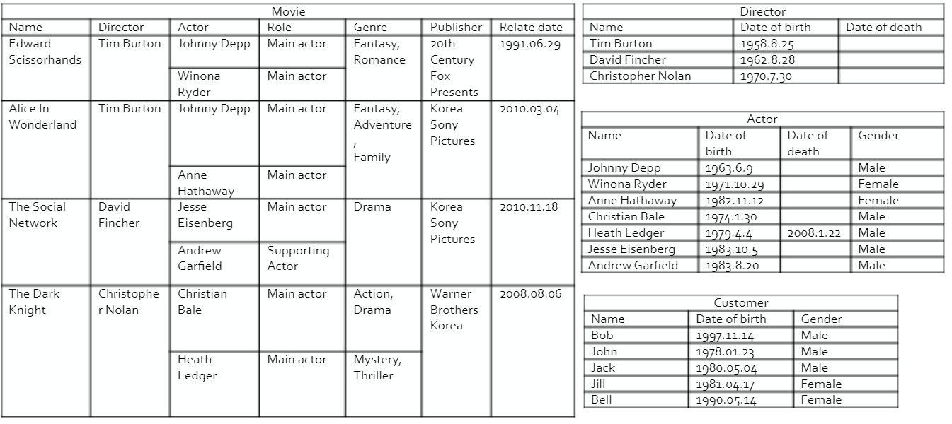
Project Description
Initial data
Notes:
As you already know, B+tree is the most Widely Used Index structure.
B+tree represents sorted data in a way that allows for efficient insertion, retrieval and removal of records, each of which is identified by a key.
In a B+ tree, all records are stored at the leaf level of the tree; only keys are stored in interior nodes.
It is a dynamic, multilevel index, with maximum and minimum bounds on the number of keys in each index segment (usually called "node").
In our disk based structure, A B+Tree stored in a single data file. A node is corresponding to a page.
Pages are stored in data file. If you need a certain page in the data file, you have to find the page and load to memory.
PID(Page ID) stores a page index in the B+Tree data file.
Using this page ID, we can seek the position of necessary node in the file.

Slide 6

Project Description
Queries
Notes:
As you already know, B+tree is the most Widely Used Index structure.
B+tree represents sorted data in a way that allows for efficient insertion, retrieval and removal of records, each of which is identified by a key.
In a B+ tree, all records are stored at the leaf level of the tree; only keys are stored in interior nodes.
It is a dynamic, multilevel index, with maximum and minimum bounds on the number of keys in each index segment (usually called "node").
In our disk based structure, A B+Tree stored in a single data file. A node is corresponding to a page.
Pages are stored in data file. If you need a certain page in the data file, you have to find the page and load to memory.
PID(Page ID) stores a page index in the B+Tree data file.
Using this page ID, we can seek the position of necessary node in the file.

Slide 7
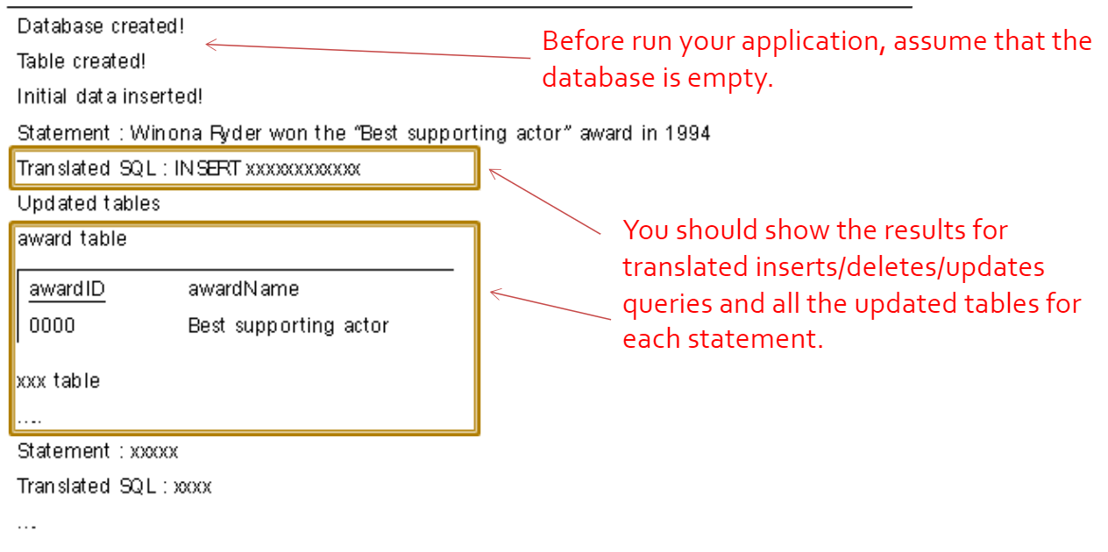
Project Description
Output example
Notes:
As you already know, B+tree is the most Widely Used Index structure.
B+tree represents sorted data in a way that allows for efficient insertion, retrieval and removal of records, each of which is identified by a key.
In a B+ tree, all records are stored at the leaf level of the tree; only keys are stored in interior nodes.
It is a dynamic, multilevel index, with maximum and minimum bounds on the number of keys in each index segment (usually called "node").
In our disk based structure, A B+Tree stored in a single data file. A node is corresponding to a page.
Pages are stored in data file. If you need a certain page in the data file, you have to find the page and load to memory.
PID(Page ID) stores a page index in the B+Tree data file.
Using this page ID, we can seek the position of necessary node in the file.

Slide 8
Project Description
Rules in project (if you don’t follow this, you can have penalty)
Programming Languages: C/C++/JAVA
DBMS: MySQL (mandatory)
You should use DB connector by ODBC(or JDBC)
DBMS setting
Database name: cs3207
Root id: root // Password: cs3207
Port: 3306
Tables are should be named as project specification
Database should be installed at localhost
Recommend full variable name not recommended: name, pw, htn recommend: username, db_passward, hostNumber
Notes:
As you already know, B+tree is the most Widely Used Index structure.
B+tree represents sorted data in a way that allows for efficient insertion, retrieval and removal of records, each of which is identified by a key.
In a B+ tree, all records are stored at the leaf level of the tree; only keys are stored in interior nodes.
It is a dynamic, multilevel index, with maximum and minimum bounds on the number of keys in each index segment (usually called "node").
In our disk based structure, A B+Tree stored in a single data file. A node is corresponding to a page.
Pages are stored in data file. If you need a certain page in the data file, you have to find the page and load to memory.
PID(Page ID) stores a page index in the B+Tree data file.
Using this page ID, we can seek the position of necessary node in the file.

Slide 9
Submission
To the I-Class website
File name form: StudentID_Name_Division_Language.zip (ex . 12110000_진영화_003분반_cpp.zip // 12121111_김학규_004분반_java.zip)
Upload a zip file containing the followings:
All the source files and execution file
README.doc explaining:
What you’ve implemented and what you’ve NOT
Brief explanation of your implementation (Do not try to make it look fancy, Less than 1 page)
How to compile and run
Display result for all queries
Talk about your experience of doing this project
Contact information (just in case)

Slide 10
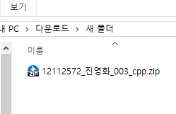

Submission
Your submitted ZIP file must have only:
main.cpp or main.java
README.doc
Example :
We will check(run) only README and main.cpp(main.java)
So, DO NOT include other module except main.cpp(main.java)
zip
Notes:
As you already know, B+tree is the most Widely Used Index structure.
B+tree represents sorted data in a way that allows for efficient insertion, retrieval and removal of records, each of which is identified by a key.
In a B+ tree, all records are stored at the leaf level of the tree; only keys are stored in interior nodes.
It is a dynamic, multilevel index, with maximum and minimum bounds on the number of keys in each index segment (usually called "node").
In our disk based structure, A B+Tree stored in a single data file. A node is corresponding to a page.
Pages are stored in data file. If you need a certain page in the data file, you have to find the page and load to memory.
PID(Page ID) stores a page index in the B+Tree data file.
Using this page ID, we can seek the position of necessary node in the file.

Slide 11
Environment setting
Install MySQL (https://dev.mysql.com/downloads/installer/)
Set DBMS
Install ODBC(C/C++) or JDBC(JAVA) (https://dev.mysql.com/downloads/connector/)
Set ODBC
Check DB connection on IDLE (Visual Studio or Eclipse etc…)
Notes:
There are three pages.
As we can see, the root page id is 3.
PID starts from 1. 0 is used to represent NULL.
Physical offset of a page in the B+Tree data file is calculated as follows:
12 + ((PID-1) * PageSize)

Slide 12
Environment setting
DBMS setting (You must follow below setting!)
Database name: cs3207
Root id: root
Password: cs3207
Port: 3306
ODBC Name: mysql_odbc
Host: localhost
Notes:
There are three pages.
As we can see, the root page id is 3.
PID starts from 1. 0 is used to represent NULL.
Physical offset of a page in the B+Tree data file is calculated as follows:
12 + ((PID-1) * PageSize)

Slide 13
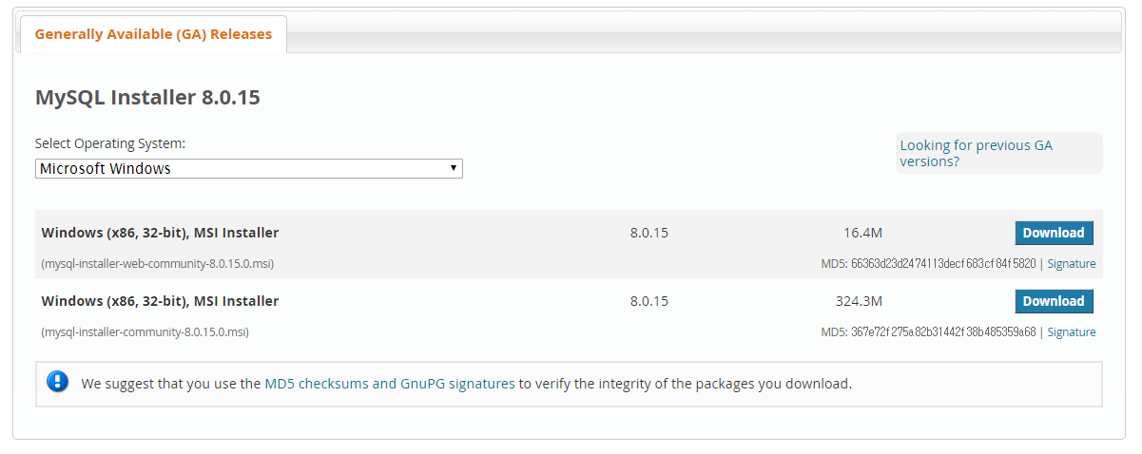
1. Install MySQL
Go to https://dev.mysql.com/downloads/installer/
Notes:
There are three pages.
As we can see, the root page id is 3.
PID starts from 1. 0 is used to represent NULL.
Physical offset of a page in the B+Tree data file is calculated as follows:
12 + ((PID-1) * PageSize)

Slide 14
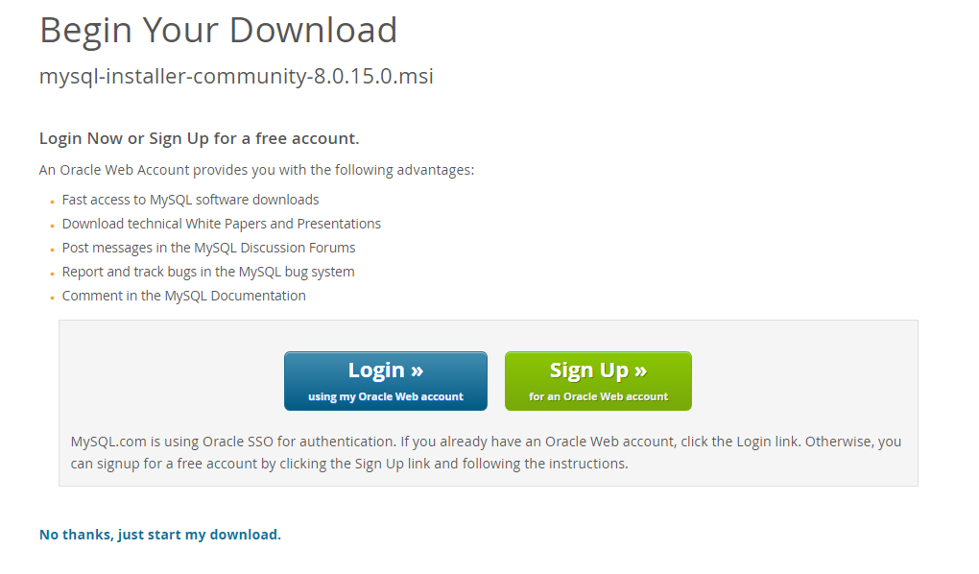
1. Install MySQL
Notes:
There are three pages.
As we can see, the root page id is 3.
PID starts from 1. 0 is used to represent NULL.
Physical offset of a page in the B+Tree data file is calculated as follows:
12 + ((PID-1) * PageSize)

Slide 15
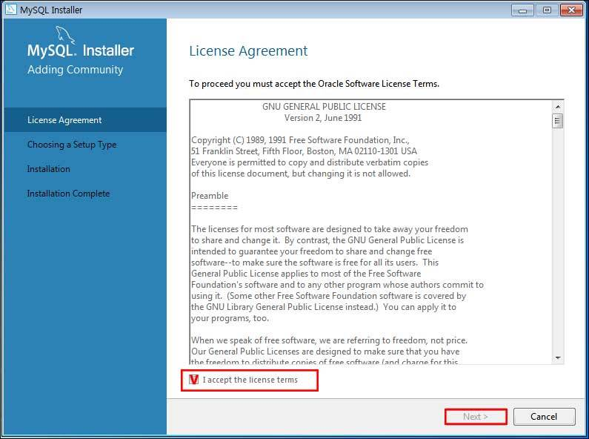
1. Install MySQL
2. Go next
Notes:
There are three pages.
As we can see, the root page id is 3.
PID starts from 1. 0 is used to represent NULL.
Physical offset of a page in the B+Tree data file is calculated as follows:
12 + ((PID-1) * PageSize)

Slide 16
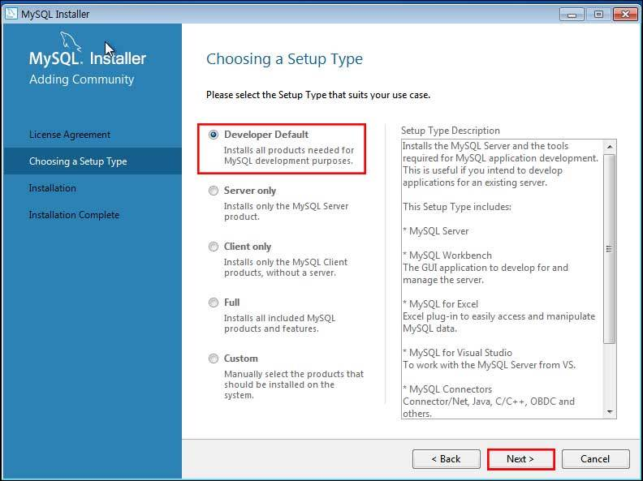
1. Install MySQL
3. Check Developer version
Notes:
There are three pages.
As we can see, the root page id is 3.
PID starts from 1. 0 is used to represent NULL.
Physical offset of a page in the B+Tree data file is calculated as follows:
12 + ((PID-1) * PageSize)

Slide 17
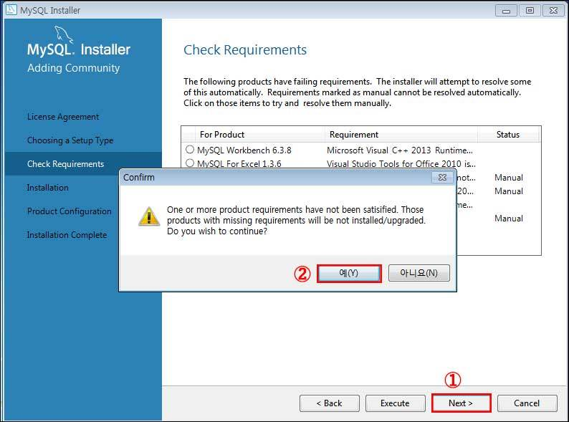
1. Install MySQL
4. Requirement checking
Notes:
There are three pages.
As we can see, the root page id is 3.
PID starts from 1. 0 is used to represent NULL.
Physical offset of a page in the B+Tree data file is calculated as follows:
12 + ((PID-1) * PageSize)

Slide 18
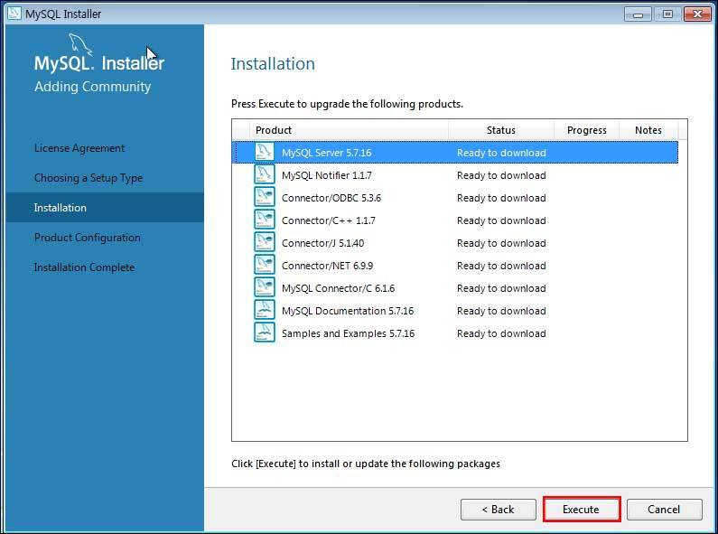
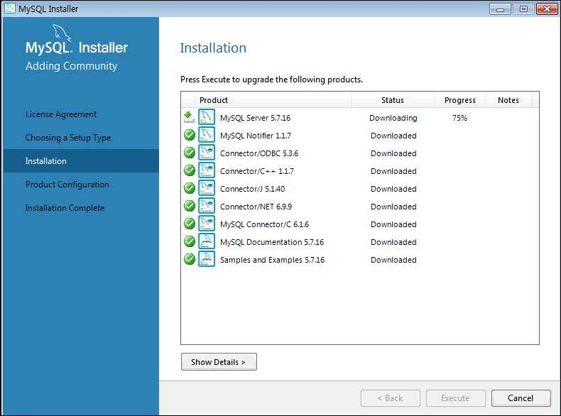
1. Install MySQL
5. Go next
Notes:
There are three pages.
As we can see, the root page id is 3.
PID starts from 1. 0 is used to represent NULL.
Physical offset of a page in the B+Tree data file is calculated as follows:
12 + ((PID-1) * PageSize)

Slide 19
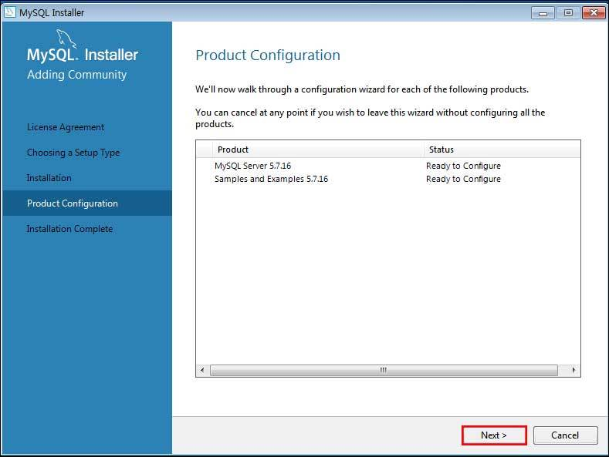
1. Install MySQL
6. Go next
Notes:
There are three pages.
As we can see, the root page id is 3.
PID starts from 1. 0 is used to represent NULL.
Physical offset of a page in the B+Tree data file is calculated as follows:
12 + ((PID-1) * PageSize)

Slide 20
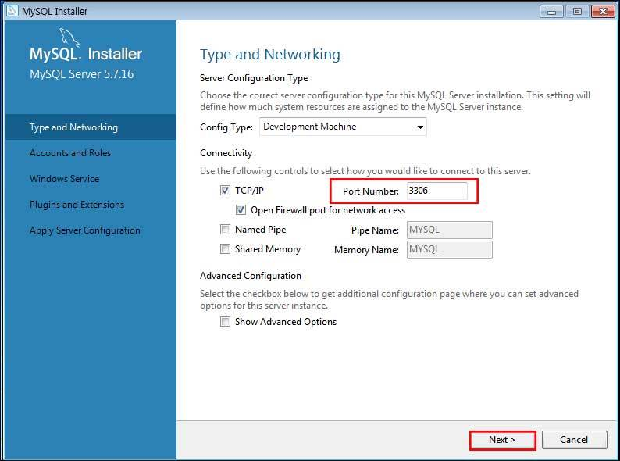
1. Install MySQL
7. Check port number (In project, you must set to 3306)
Notes:
There are three pages.
As we can see, the root page id is 3.
PID starts from 1. 0 is used to represent NULL.
Physical offset of a page in the B+Tree data file is calculated as follows:
12 + ((PID-1) * PageSize)

Slide 21
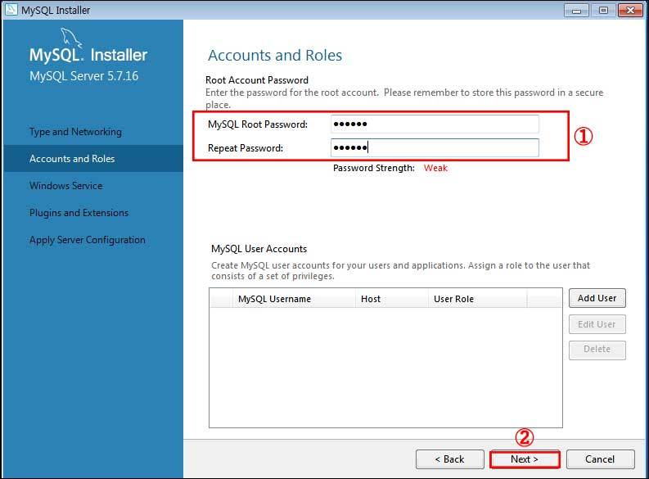
1. Install MySQL
8. Set Root password (In project, password is ‘cs3207’)
Notes:
There are three pages.
As we can see, the root page id is 3.
PID starts from 1. 0 is used to represent NULL.
Physical offset of a page in the B+Tree data file is calculated as follows:
12 + ((PID-1) * PageSize)

Slide 22
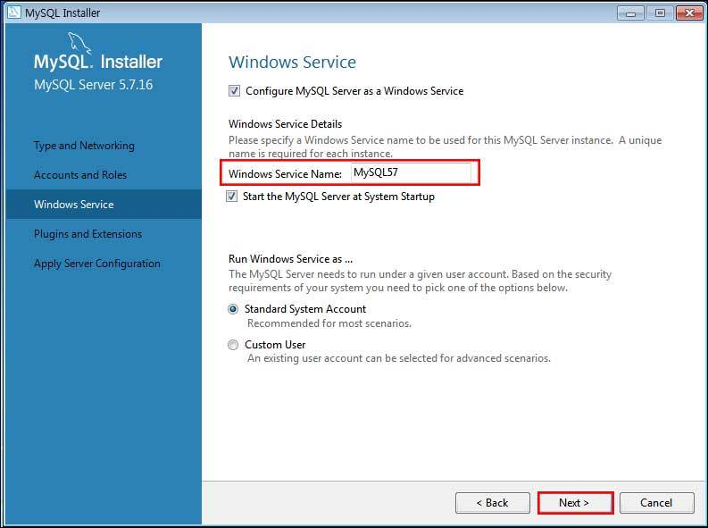
1. Install MySQL
9. Set Windows Service Name
Notes:
There are three pages.
As we can see, the root page id is 3.
PID starts from 1. 0 is used to represent NULL.
Physical offset of a page in the B+Tree data file is calculated as follows:
12 + ((PID-1) * PageSize)

Slide 23
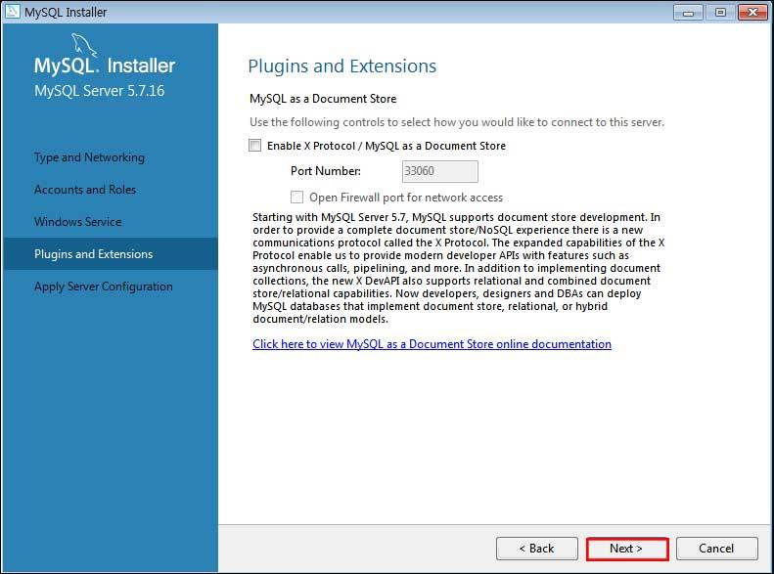
1. Install MySQL
10. Go next
Notes:
There are three pages.
As we can see, the root page id is 3.
PID starts from 1. 0 is used to represent NULL.
Physical offset of a page in the B+Tree data file is calculated as follows:
12 + ((PID-1) * PageSize)

Slide 24
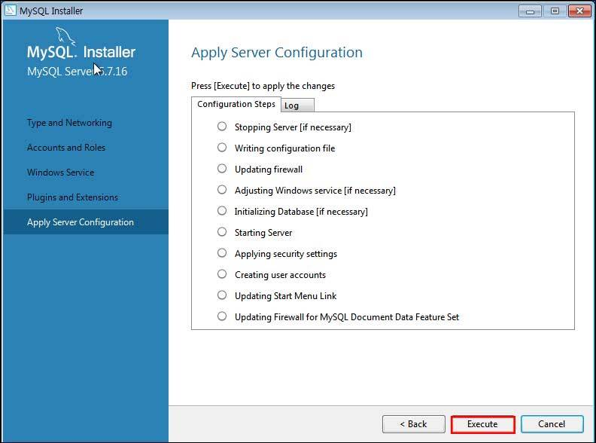
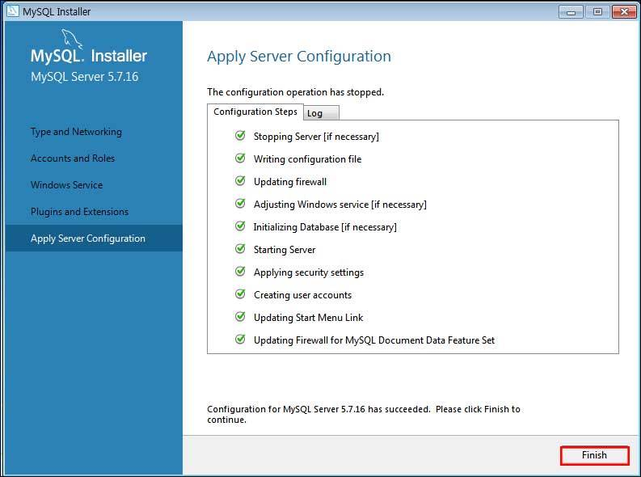
1. Install MySQL
11. Go next
Notes:
There are three pages.
As we can see, the root page id is 3.
PID starts from 1. 0 is used to represent NULL.
Physical offset of a page in the B+Tree data file is calculated as follows:
12 + ((PID-1) * PageSize)

Slide 25
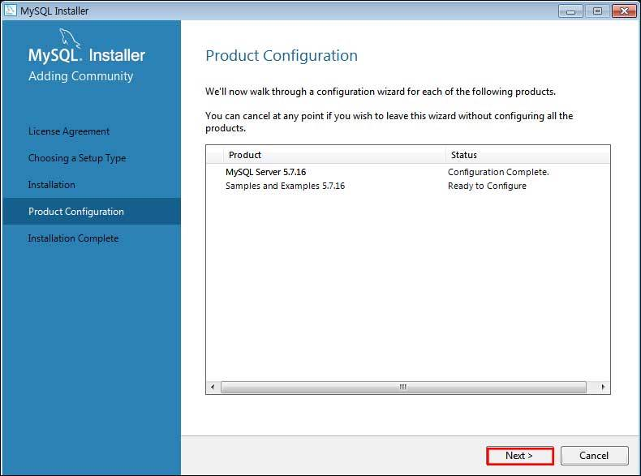
1. Install MySQL
12. Go next
Notes:
There are three pages.
As we can see, the root page id is 3.
PID starts from 1. 0 is used to represent NULL.
Physical offset of a page in the B+Tree data file is calculated as follows:
12 + ((PID-1) * PageSize)

Slide 26
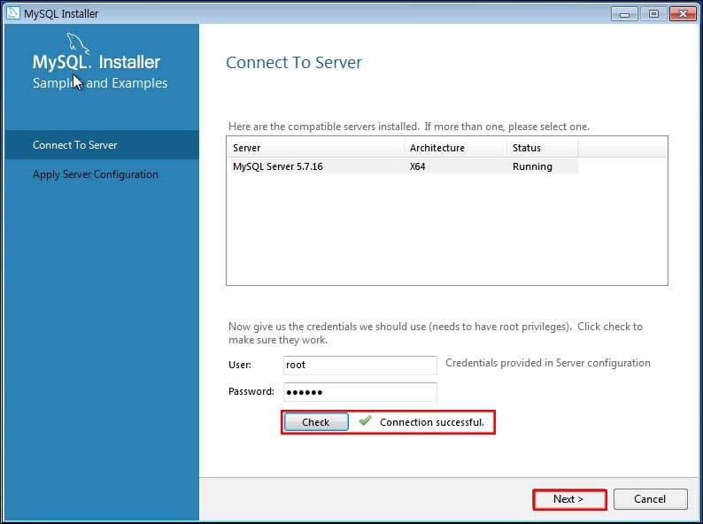
1. Install MySQL
13. Input username and password(User: root, Password: cs3207)
Notes:
There are three pages.
As we can see, the root page id is 3.
PID starts from 1. 0 is used to represent NULL.
Physical offset of a page in the B+Tree data file is calculated as follows:
12 + ((PID-1) * PageSize)

Slide 27
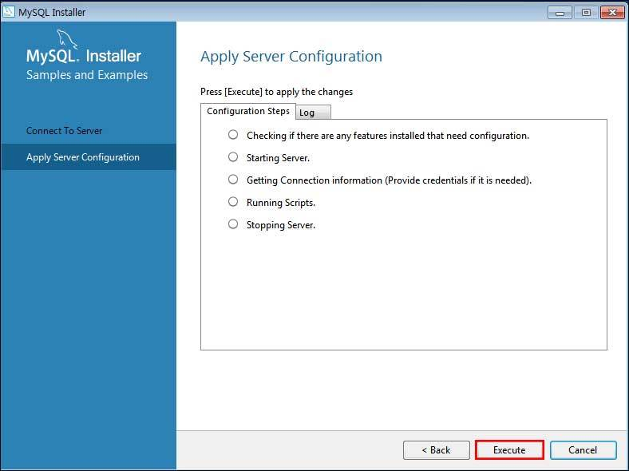
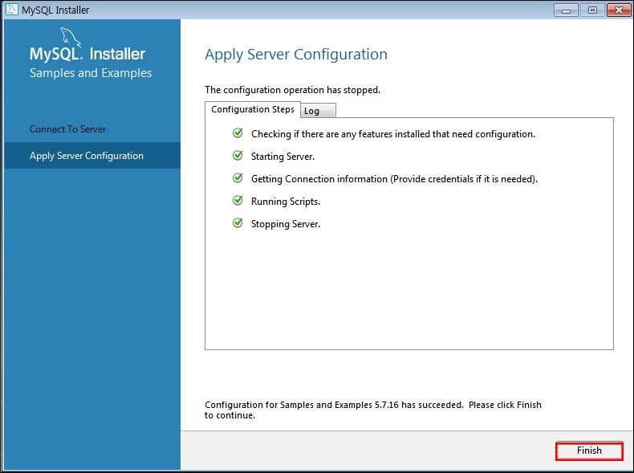
1. Install MySQL
14. Go next
Notes:
There are three pages.
As we can see, the root page id is 3.
PID starts from 1. 0 is used to represent NULL.
Physical offset of a page in the B+Tree data file is calculated as follows:
12 + ((PID-1) * PageSize)

Slide 28
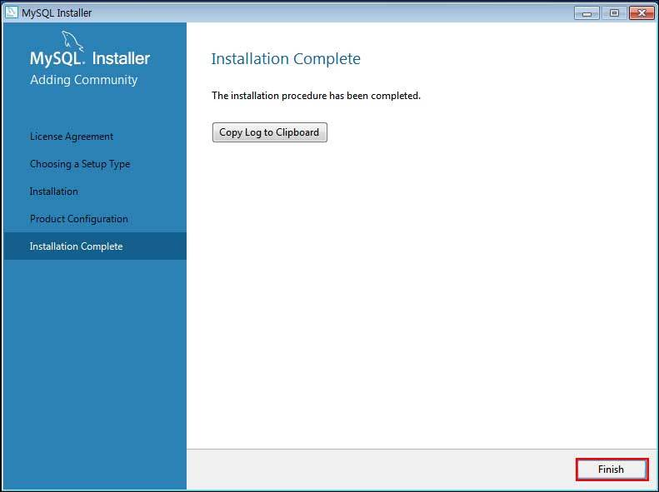
1. Install MySQL
15. Finish install
Notes:
There are three pages.
As we can see, the root page id is 3.
PID starts from 1. 0 is used to represent NULL.
Physical offset of a page in the B+Tree data file is calculated as follows:
12 + ((PID-1) * PageSize)

Slide 29
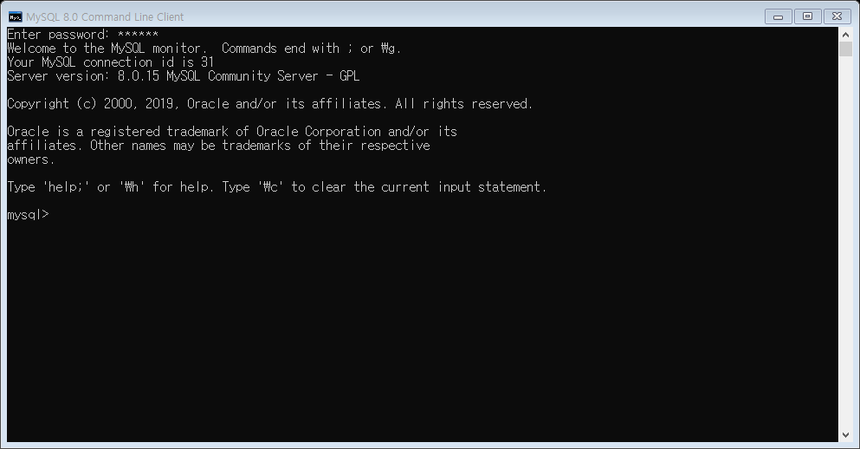
1. Install MySQL
16. Run MySQL x.x Command Line Client
Notes:
There are three pages.
As we can see, the root page id is 3.
PID starts from 1. 0 is used to represent NULL.
Physical offset of a page in the B+Tree data file is calculated as follows:
12 + ((PID-1) * PageSize)

Slide 30
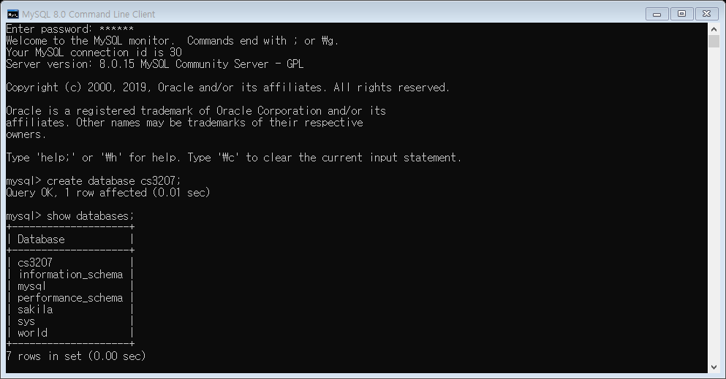
1. Install MySQL
17. Make ‘cs3207’ database and finish
Notes:
There are three pages.
As we can see, the root page id is 3.
PID starts from 1. 0 is used to represent NULL.
Physical offset of a page in the B+Tree data file is calculated as follows:
12 + ((PID-1) * PageSize)

Slide 31
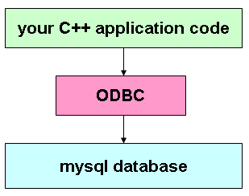
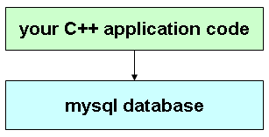
2. Install ODBC
What is ODBC?
Open DataBase Connectivity : standard application programming interface (API) for accessing database management systems (DBMS)
Notes:
There are three pages.
As we can see, the root page id is 3.
PID starts from 1. 0 is used to represent NULL.
Physical offset of a page in the B+Tree data file is calculated as follows:
12 + ((PID-1) * PageSize)

Slide 32
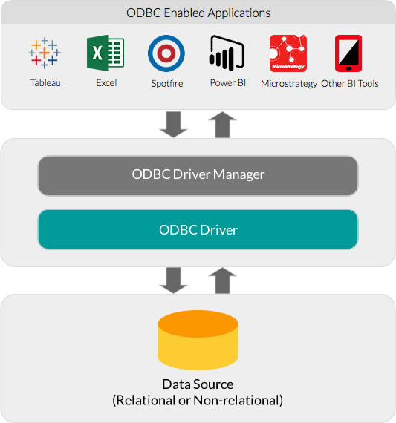
2. Install ODBC
What is ODBC?
Notes:
There are three pages.
As we can see, the root page id is 3.
PID starts from 1. 0 is used to represent NULL.
Physical offset of a page in the B+Tree data file is calculated as follows:
12 + ((PID-1) * PageSize)

Slide 33
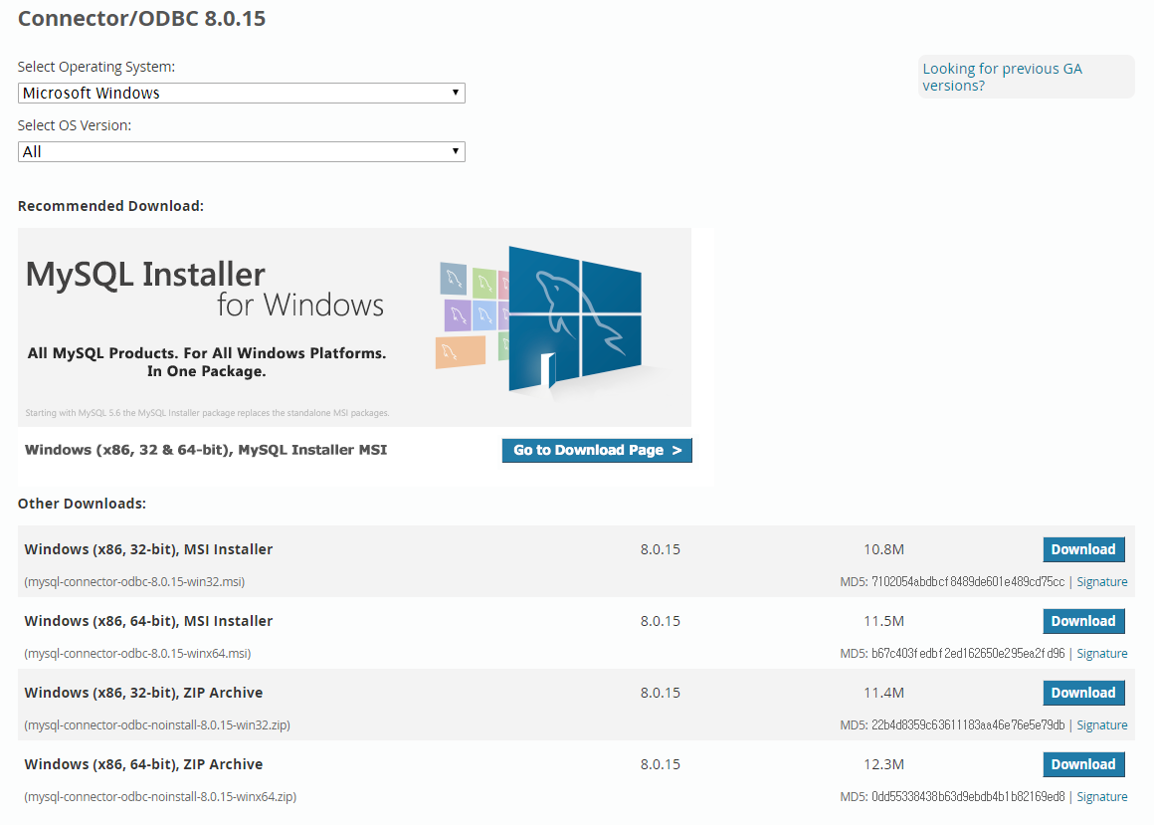
2. Install ODBC (C/C++)
Go to https://dev.mysql.com/downloads/connector/odbc/
Notes:
There are three pages.
As we can see, the root page id is 3.
PID starts from 1. 0 is used to represent NULL.
Physical offset of a page in the B+Tree data file is calculated as follows:
12 + ((PID-1) * PageSize)

Slide 34
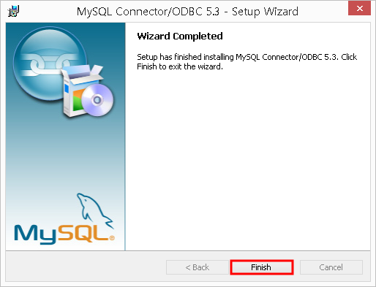
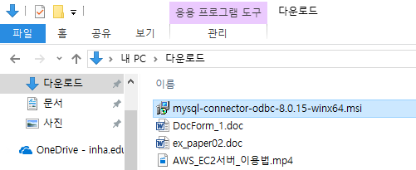
2. Install ODBC (C/C++)
2. Install MySQL ODBC connector
Notes:
There are three pages.
As we can see, the root page id is 3.
PID starts from 1. 0 is used to represent NULL.
Physical offset of a page in the B+Tree data file is calculated as follows:
12 + ((PID-1) * PageSize)

Slide 35
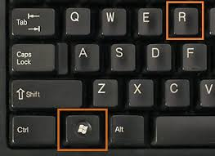
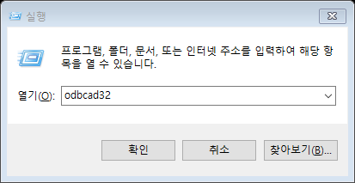
2. Install ODBC (C/C++)
3. Press the win + R, and run ODBC Data Source Administrator
Notes:
There are three pages.
As we can see, the root page id is 3.
PID starts from 1. 0 is used to represent NULL.
Physical offset of a page in the B+Tree data file is calculated as follows:
12 + ((PID-1) * PageSize)

Slide 36
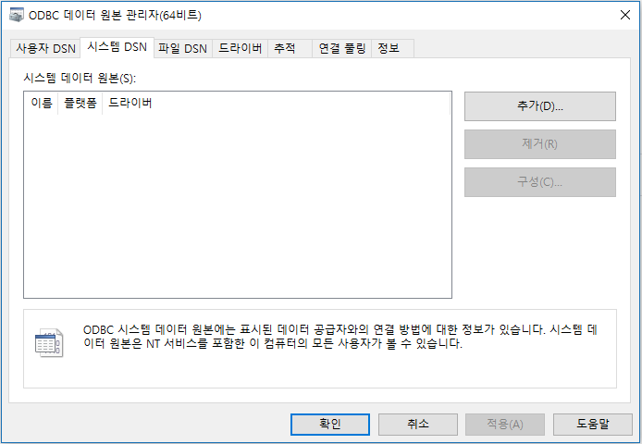
2. Install ODBC (C/C++)
3. Go system DSN tap, and click add button
①
②
Notes:
There are three pages.
As we can see, the root page id is 3.
PID starts from 1. 0 is used to represent NULL.
Physical offset of a page in the B+Tree data file is calculated as follows:
12 + ((PID-1) * PageSize)

Slide 37
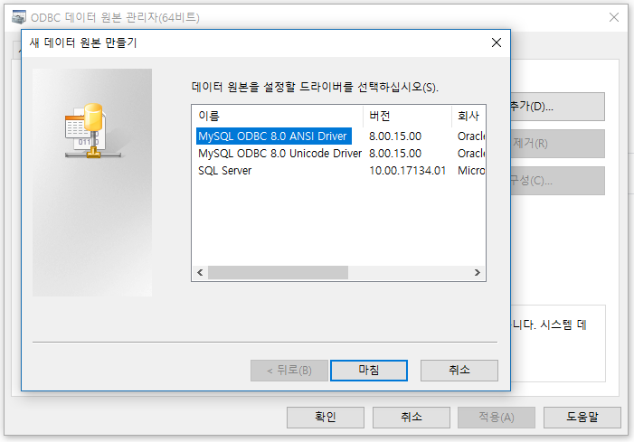
2. Install ODBC (C/C++)
4. Press the win + R, and run ODBC Data Source Administrator
Notes:
There are three pages.
As we can see, the root page id is 3.
PID starts from 1. 0 is used to represent NULL.
Physical offset of a page in the B+Tree data file is calculated as follows:
12 + ((PID-1) * PageSize)

Slide 38
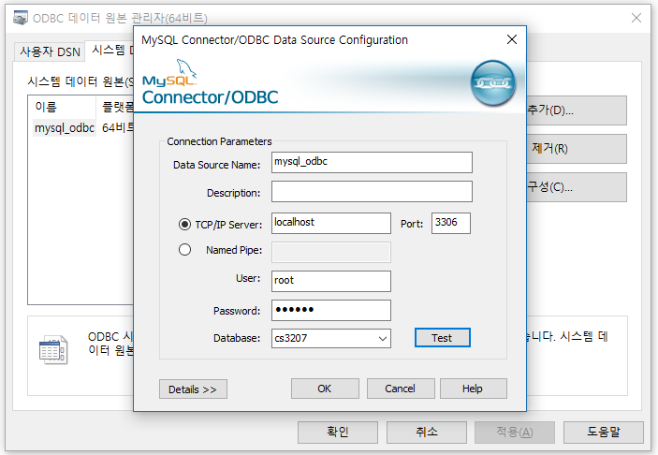
2. Install ODBC (C/C++)
5. Set MySQL Connector Configuration
Notes:
There are three pages.
As we can see, the root page id is 3.
PID starts from 1. 0 is used to represent NULL.
Physical offset of a page in the B+Tree data file is calculated as follows:
12 + ((PID-1) * PageSize)

Slide 39
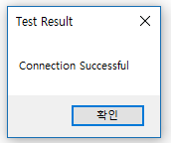
2. Install ODBC (C/C++)
6. If configuration finished, click test button
Notes:
There are three pages.
As we can see, the root page id is 3.
PID starts from 1. 0 is used to represent NULL.
Physical offset of a page in the B+Tree data file is calculated as follows:
12 + ((PID-1) * PageSize)

Slide 40
2. Install ODBC (C/C++)
7. Test is OK, then finish setting
Notes:
There are three pages.
As we can see, the root page id is 3.
PID starts from 1. 0 is used to represent NULL.
Physical offset of a page in the B+Tree data file is calculated as follows:
12 + ((PID-1) * PageSize)

Slide 41
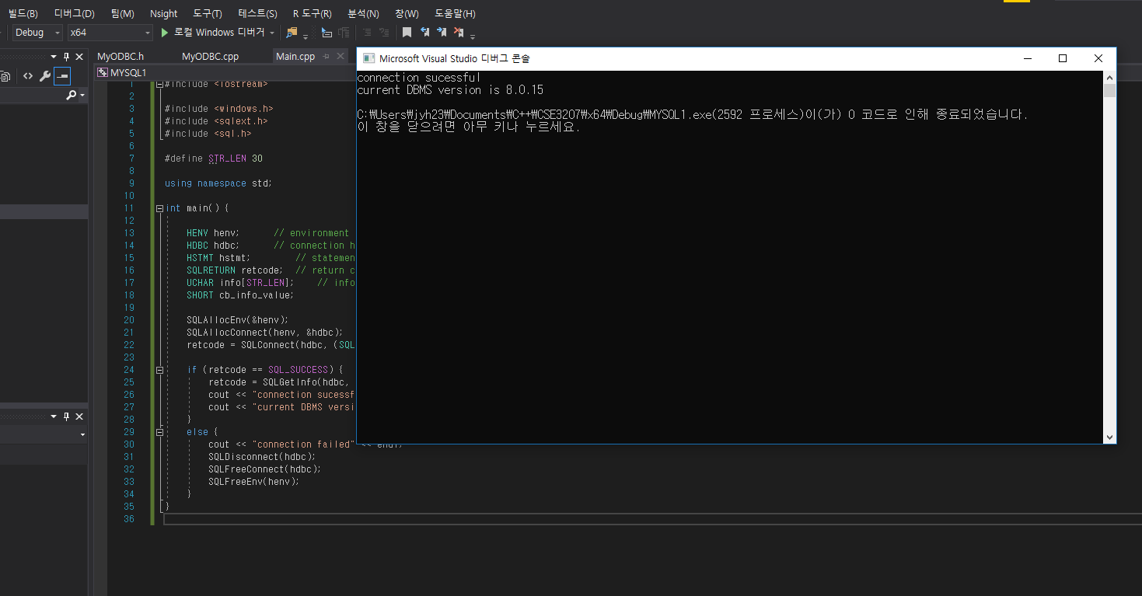
2. Install ODBC (C/C++)
8. test DB connection in visual studio
Be careful 32bit, 64bit
Notes:
There are three pages.
As we can see, the root page id is 3.
PID starts from 1. 0 is used to represent NULL.
Physical offset of a page in the B+Tree data file is calculated as follows:
12 + ((PID-1) * PageSize)

Slide 42
2. Install ODBC (C/C++)
Connection test sample code
#include <iostream>
#include <Windows.h>
#include <sqlext.h>
#include <sql.h>
#define STR_LEN 30
using namespace std;
int main() {
HENV henv; // environment handle
HDBC hdbc; // connection handle
HSTMT hstmt; // statement handle
SQLRETURN retcode; // return code
UCHAR info[STR_LEN]; // info string for SQLGetInfo
SHORT cb_info_value;
SQLAllocEnv(&henv);
SQLAllocConnect(henv, &hdbc);
retcode = SQLConnect(hdbc, (SQLCHAR*)"mysql_odbc", SQL_NTS, (SQLCHAR*)"root", SQL_NTS, (SQLCHAR*)"cs3207", SQL_NTS);
if (retcode == SQL_SUCCESS) {
retcode = SQLGetInfo(hdbc, SQL_DBMS_VER, &info, STR_LEN, &cb_info_value);
cout << "connection sucessful" << endl;
cout << "current DBMS version is " << info << endl;
}
else {
cout << "connection failed" << endl;
SQLDisconnect(hdbc);
SQLFreeConnect(hdbc);
SQLFreeEnv(henv);
}
}
Notes:
There are three pages.
As we can see, the root page id is 3.
PID starts from 1. 0 is used to represent NULL.
Physical offset of a page in the B+Tree data file is calculated as follows:
12 + ((PID-1) * PageSize)

Slide 43
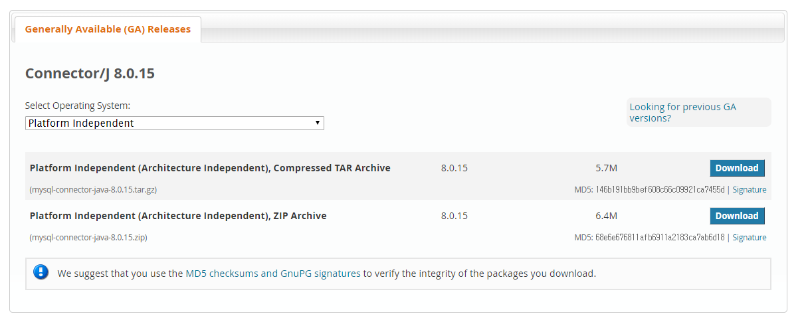
2. Install JDBC (Java)
Go to https://dev.mysql.com/downloads/connector/j/
Download and unzip file
Notes:
There are three pages.
As we can see, the root page id is 3.
PID starts from 1. 0 is used to represent NULL.
Physical offset of a page in the B+Tree data file is calculated as follows:
12 + ((PID-1) * PageSize)

Slide 44


2. Install JDBC (Java)
Prepare ‘mysql-connector-java-8.0.15-bin.jar’ file
Add library in JAVA idle In eclipse, Properties – Java Build Path – Libraries – Add External JARs In IntelliJ, Project Structure – Libraries – click + button – Java – find jar file
test DB connection in Java Idle
Notes:
There are three pages.
As we can see, the root page id is 3.
PID starts from 1. 0 is used to represent NULL.
Physical offset of a page in the B+Tree data file is calculated as follows:
12 + ((PID-1) * PageSize)

Slide 45
Environment setting
Recommended: Google know much more than me, so ask to google!
You can have help from some instruction
생활코딩 [https://opentutorials.org/course/3161/19531]
ODBC Programmer’s Guide [http://www.dbmaker.com.tw/ftp/pub/DBMaker/document/english/5.4/odbc.pdf]
JDBC Quick Guide [https://www.tutorialspoint.com/jdbc/jdbc-quick-guide.htm]
Should you have any problem in progress, feel free to contact me ☺
(jyh2378@naver.com, bigdata lab room 1414)
Notes:
There are three pages.
As we can see, the root page id is 3.
PID starts from 1. 0 is used to represent NULL.
Physical offset of a page in the B+Tree data file is calculated as follows:
12 + ((PID-1) * PageSize)

